Slide 1
Tomcat and eclipse configuration Amirtha

Slide 2
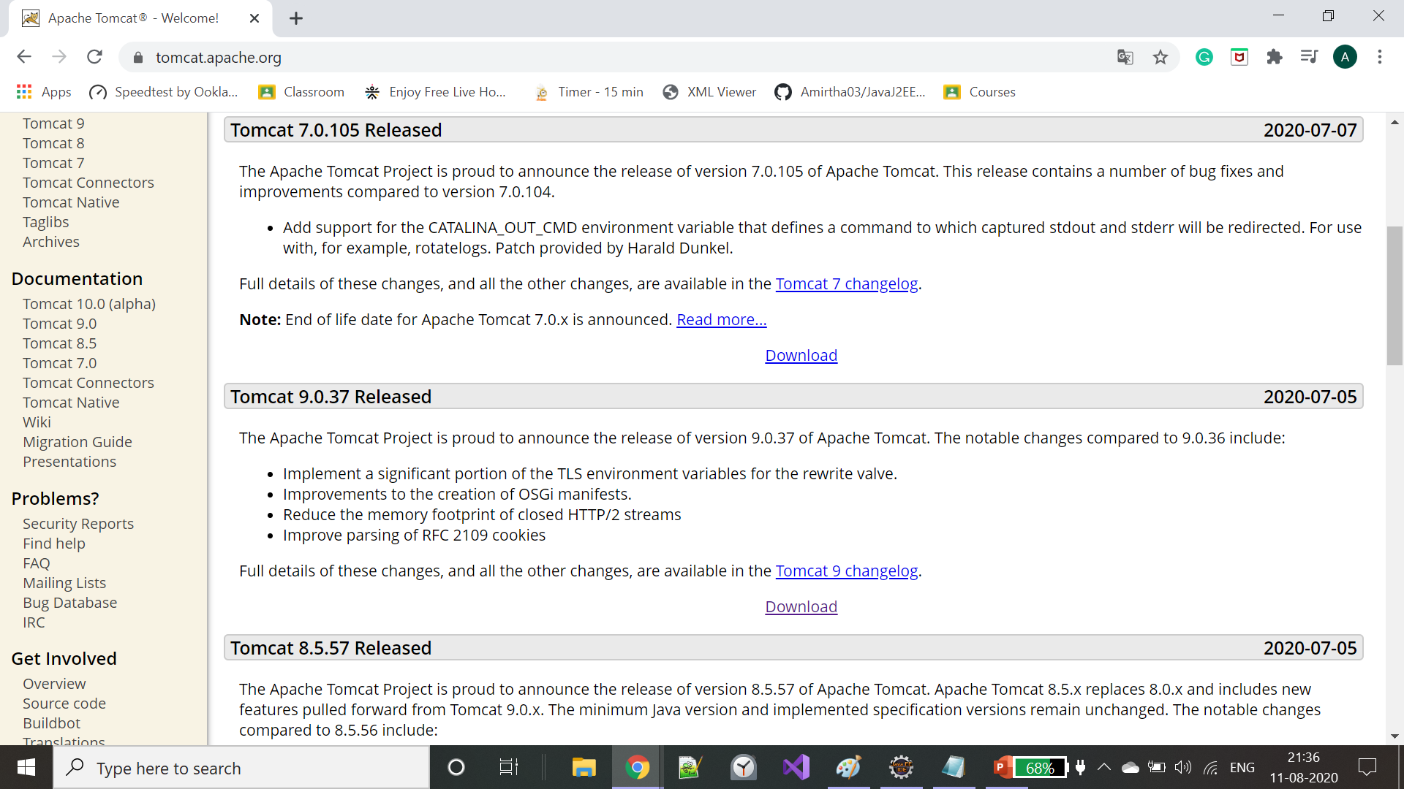
Goto https://tomcat.apache.org/ and download Tomcat 9.0.37 Released/any version of your choice

Slide 3
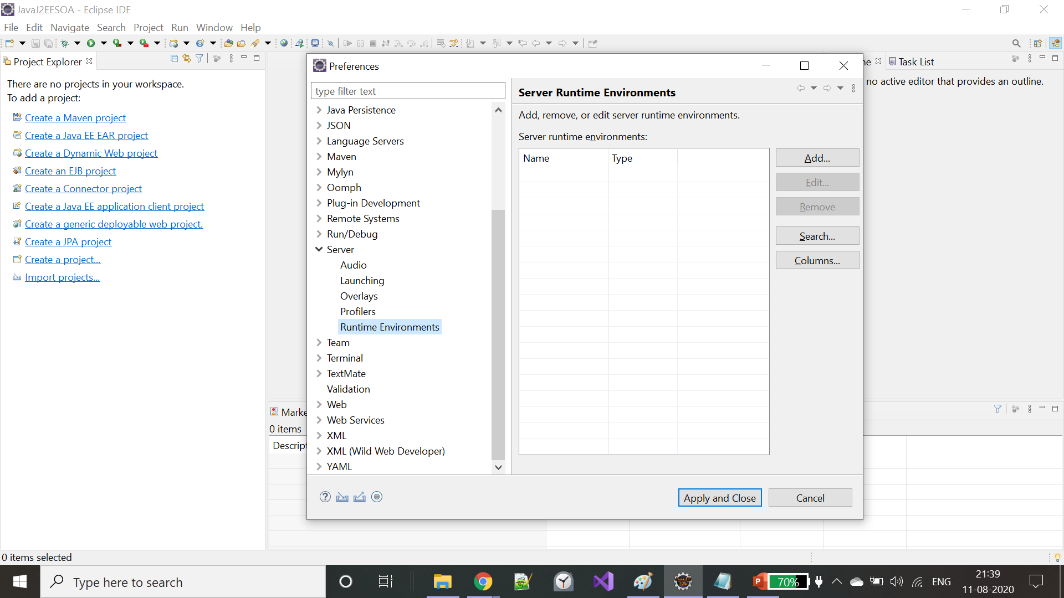
Run apache-tomcat-9.0.37.exe and got to eclipse -> window -> Preferences -> Server -> Run time Environments

Slide 4
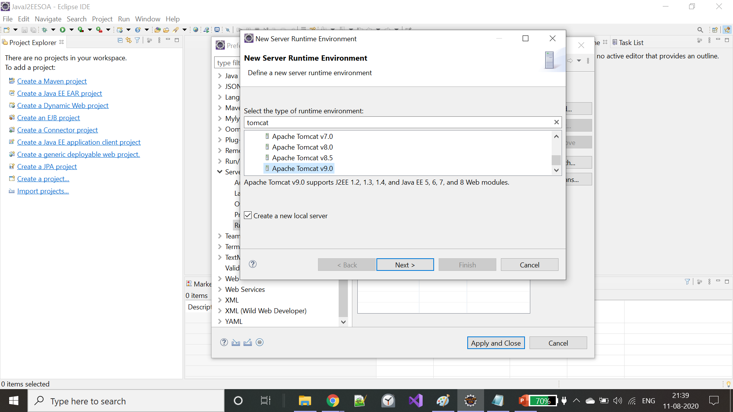
Click on Add on the right side and select the installed tomcat version and click next

Slide 5
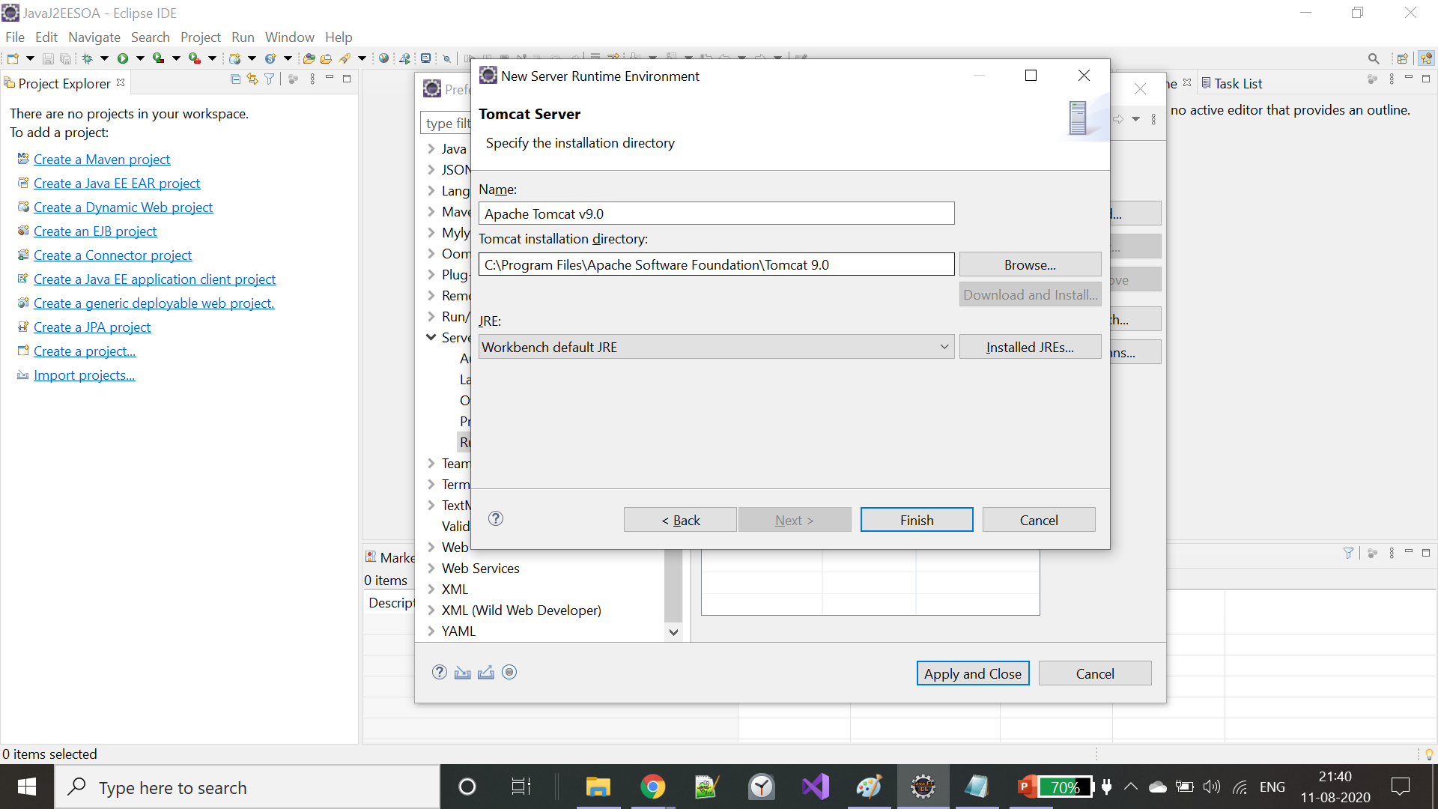
Browse your tomcat directory and click finish

Slide 6
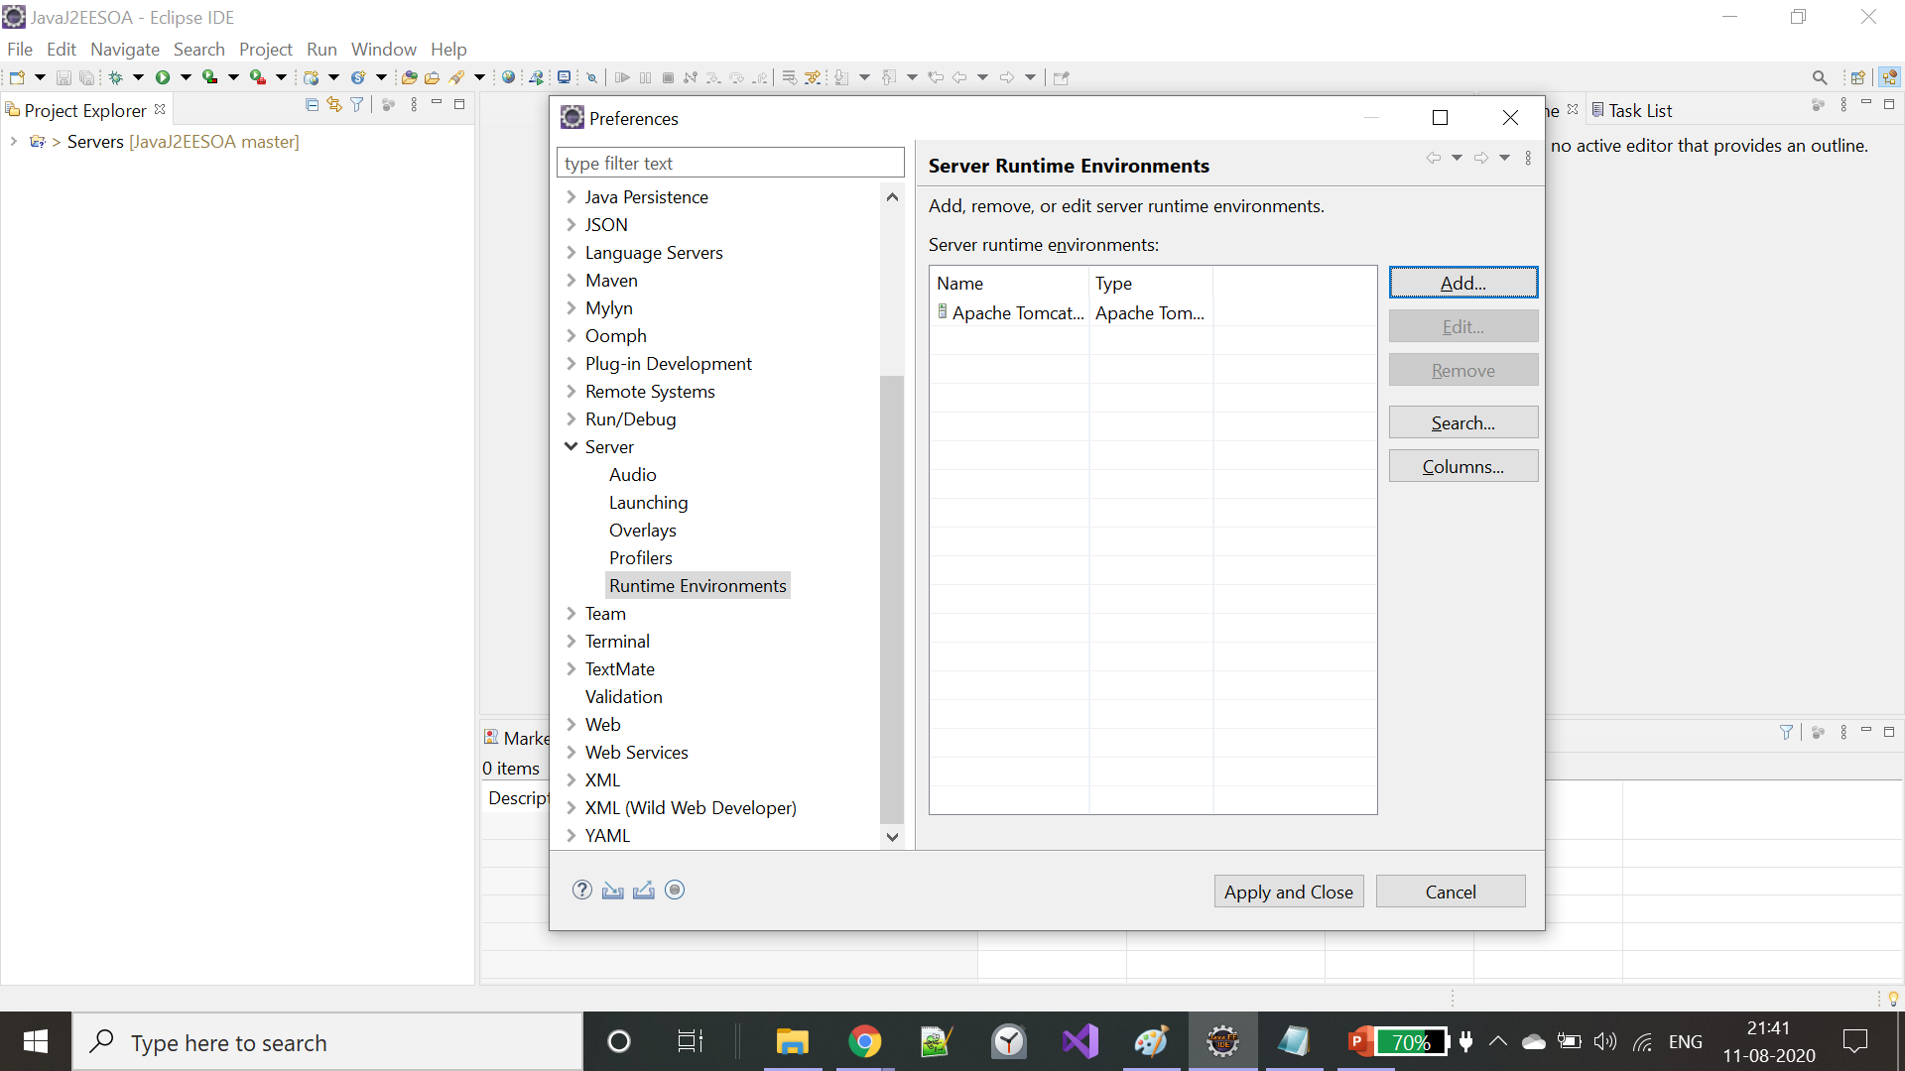
Click Apply and close

Slide 7
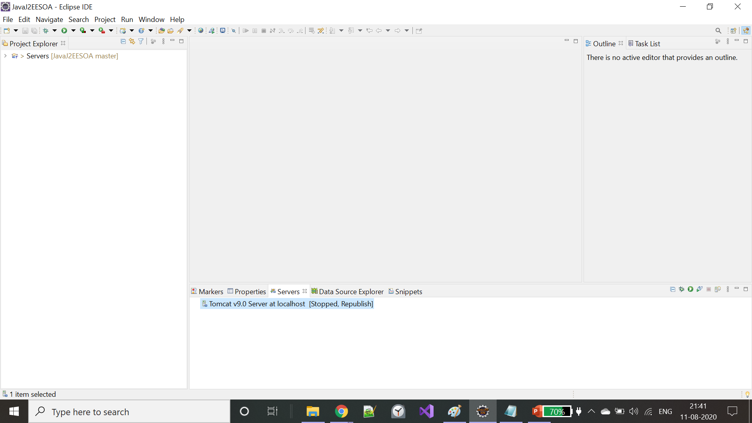
You can locate tomcat server under Servers tab

Slide 8
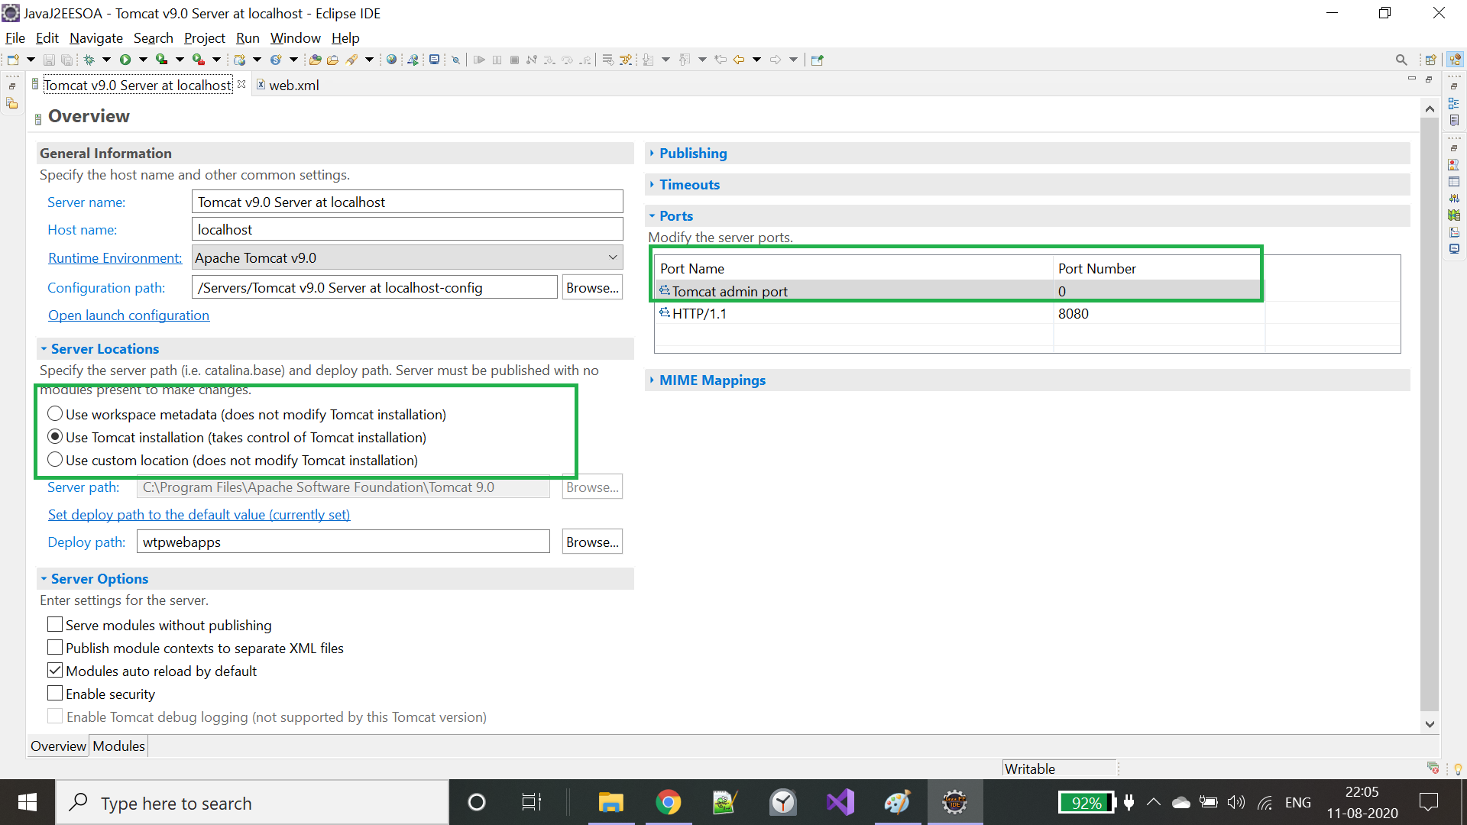
Double click on tomcat server 1. Choose use tomcat installation under server locations 2. Enter a Tomcat admin port number under Ports tab

Slide 9
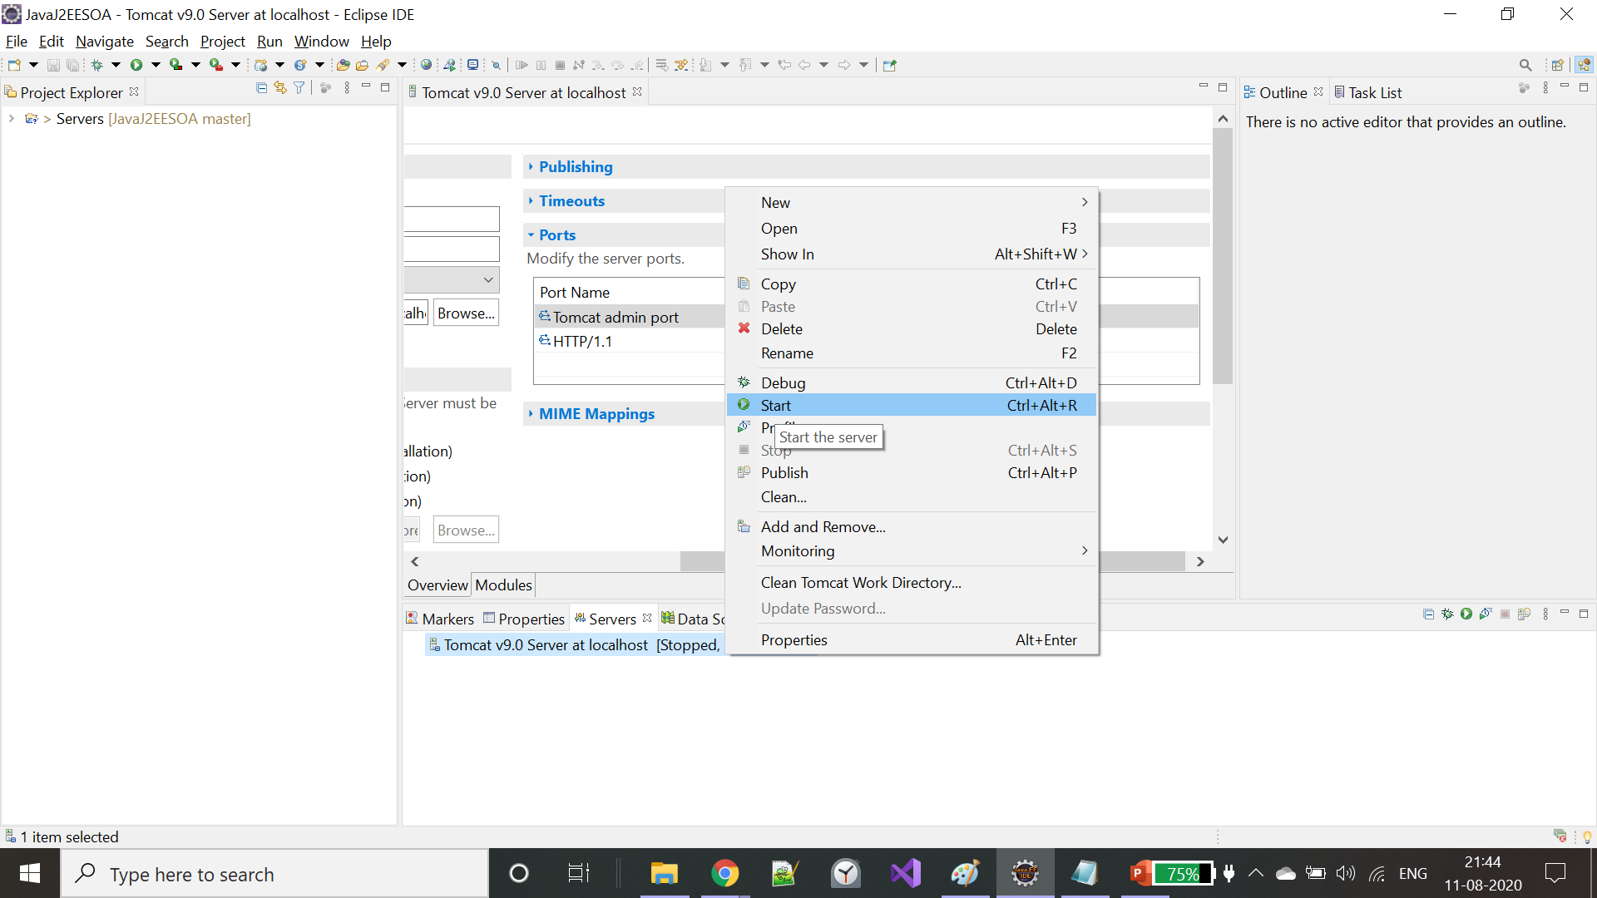
Right click on tomcat server and click start

Slide 10
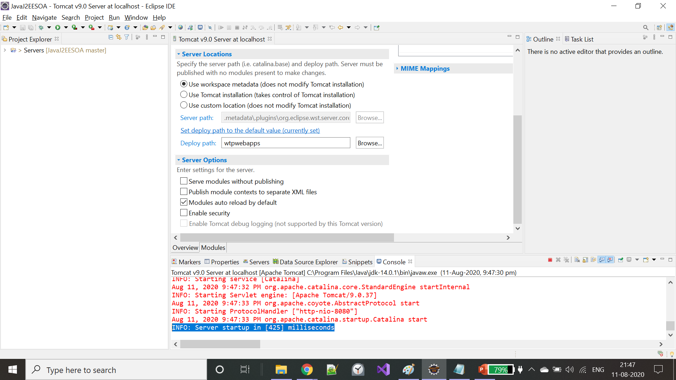
Click start again and click save on the dialog box. Check the console now for the highlighted message.

Slide 11
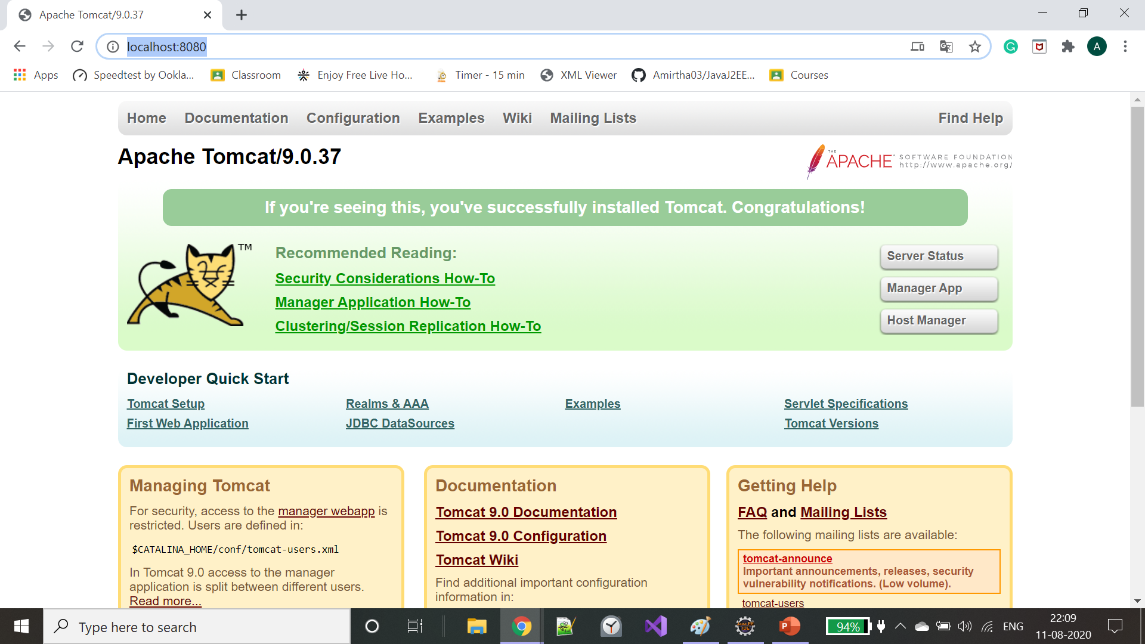
Access http://localhost:8080/ on any browser for validation. Done ☺

Slide 12
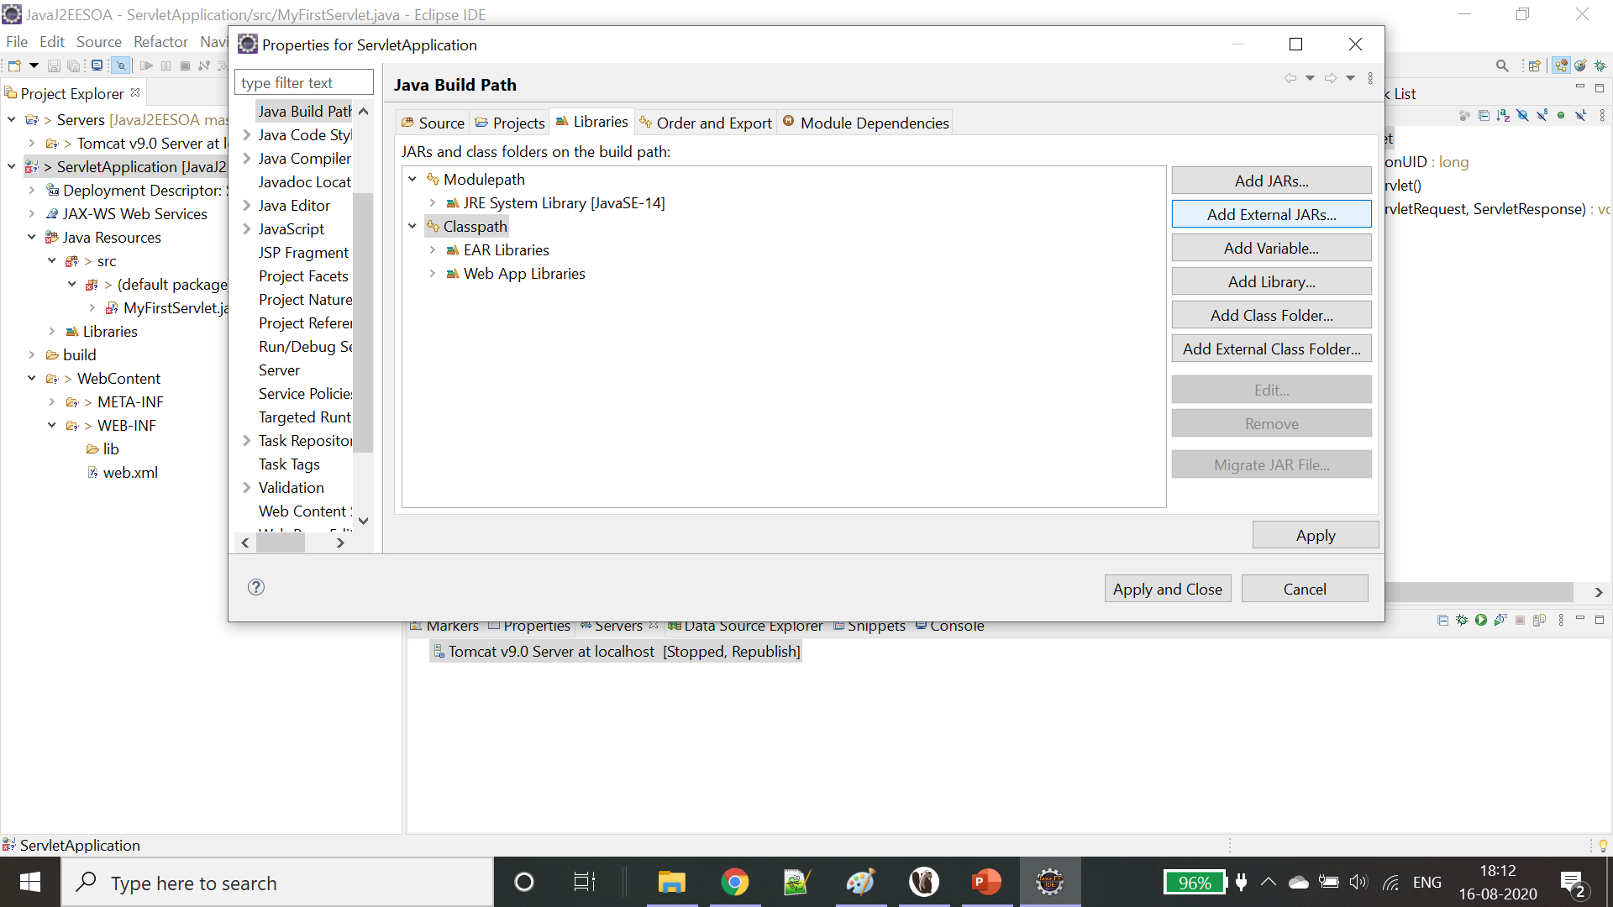
Add servlet api in build path -> right click on project -> build path -> configure build path -> Add external jars

Slide 13
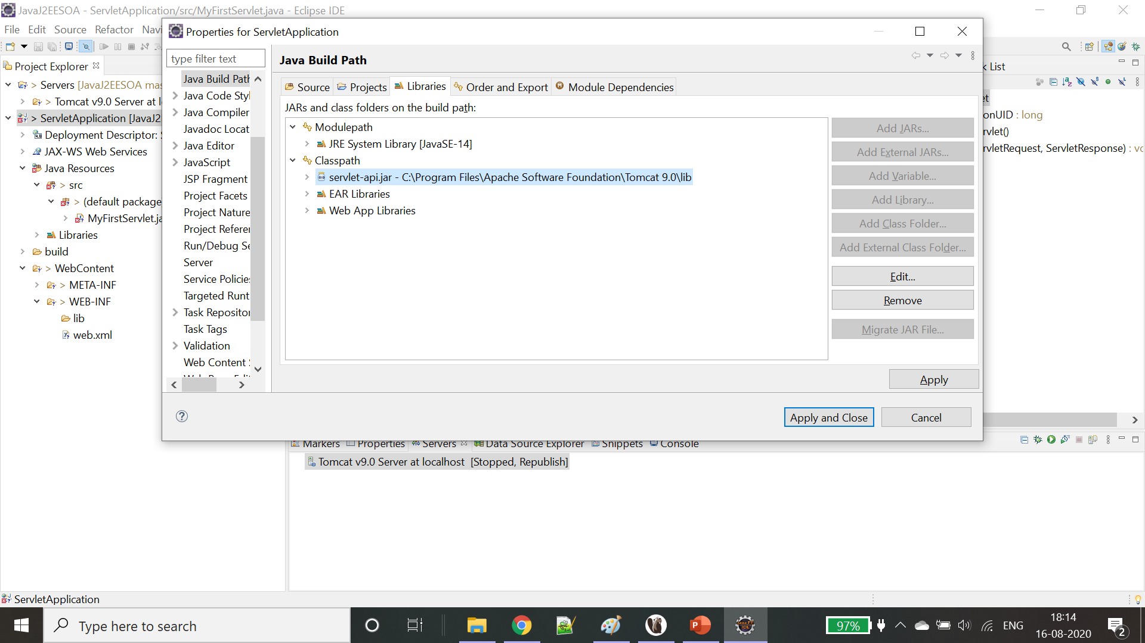
Servlet jar can be located inside C:\Program Files\Apache Software Foundation\Tomcat 9.0\lib

